Slide 1
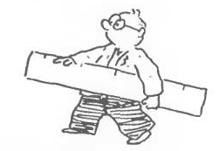
Graphical Representations
Quantitative Variables
Grouped Frequency
Table
Graphs
Histogram
Ogive Graph
Box Plot
Dr. Abolfazl Saghafi
Assistant Professor of Statistics & Data Science
Data Science Program Director
Notes:
These three are the most common summarization techniques for quantitative data

Slide 2
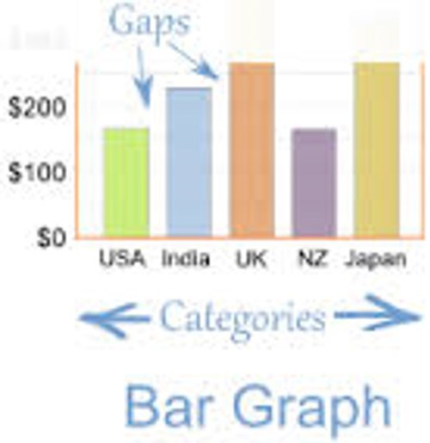
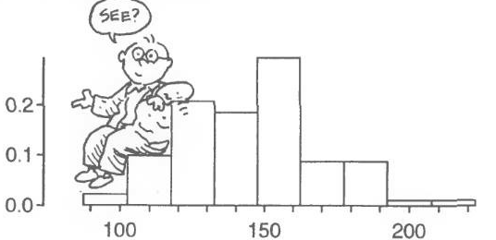
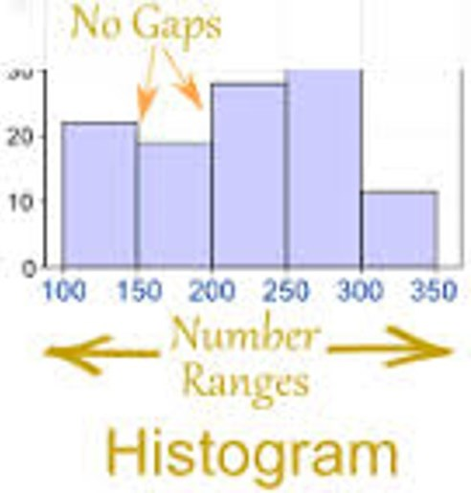
Histogram
* There are TWO differences between bar charts and histograms
A histogram is representation of a frequency distribution by way of rectangles whose width represents the class interval and heights are proportional to relative frequencies.
Notes:
Can you figure out the two differences between a histogram and a bar chart?

Slide 3
Histogram for Discrete Data
General Layout:
Quantitative Data
⬇
Listed Data
⬇
Frequency Table
⬇
Histogram
For discrete quantitative data, we simply create a frequency table and remove the gap between outcomes. for example:
2 3 4 4 3 3 5 6 5 4 3 3 4
1. Generate a frequency table
2. Generate Boundaries 3. Graph the histogram
Boundaries
[ 1.5 , 2.5 )
[ 2.5 , 3.5 )
[ 3.5 , 4.5 )
[ 4.5 , 5.5 )
[ 5.5 , 6.5 )
outcome | frequency
2 | 1
3 | 5
4 | 4
5 | 2
6 | 1
Freq
5
1
2
3
4
5
6
Notes:
Mark the boundaries OR the representative of each class on x-axis. Then draw rectangles proportional to the frequencies or relative frequencies.

Slide 4
Histogram for Continuous Data
General Layout:
Range & Tolerance
⬇
Class Width
⬇
Class Limits
(LCL & UCL)
⬇
Class Midpoints
(Marks)
⬇
Class Boundaries
⬇
Frequency Table
⬇
Histogram
A random sample of 50 pieces of nylon rope’s breaking strength (kN) is recorded. Graph a histogram with 5 classes.
6.8 7.1 7.7 7.8 7.9 7.9 8.3 8.5 8.5 8.5 8.7 8.7 8.8 8.8 8.8 9 9.2 9.3 9.4 9.4 9.5 9.6 9.6 9.6 9.7 9.7 9.8 10 10.1 10.1 10.2 10.3 10.4 10.6 10.7 10.9 10.9 11.1 11.3 11.3 11 11.5 11.5 11.7 12 12.1 12.6 12.9 13 13.7
Range = Max – min= 13.7- 6.8 = 6.9
Tolerance = 0.1
Tolerance depends on the data rounding unit. If you round to the nearest integer the tolerance is 1, if you round toward nearest decimal, it is 0.1
Notes:
We need to go through a couple of steps to graph a histogram for continuous quantitative data. Here we follow the steps with an example.
Excel might graph a slightly different histogram, it’s ok

Slide 5
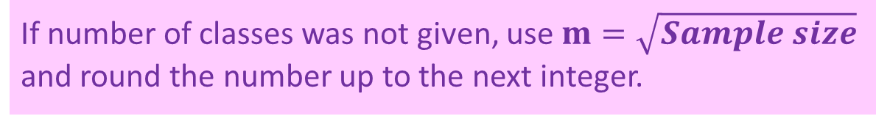
General Layout:
Class width: CW = ROUND(Range/m)
Range (6.9) & Tol (0.1)
⬇
Class Width
⬇
Class Limits
(LCL & UCL)
⬇
Class Midpoints
(Marks)
⬇
Class Boundaries
⬇
Frequency Table
⬇
Histogram
Number of Classes
5 ≤ m ≤ 12
CW = ROUND(6.9 / 5)
= ROUND(1.38)
Round Up
normally with the same decimal points as the data
= 1.4
Necessary: m × class width > Range
5
1.4
If number of classes was not given, use $m=\sqrt{Sample size}$ and round the number up to the next integer.
Notes:
Technically we need five classes, so if we divide the range by 5 we will get the length of each interval.
We round the number for CW upward since if we don’t, we cannot cover the whole range of numbers with 5 categories

Slide 6
Class limits are open intervals on the real number line, each class limit consists of a lower value called the lower class limit (LCL) and an upper value called the upper class limit (UCL). In each category we have:
General Layout:
Range (6.9) & Tol (0.1)
⬇
Class Width (1.4)
⬇
Class Limits
(LCL & UCL)
⬇
Class Midpoints
(Marks)
⬇
Class Boundaries
⬇
Frequency Table
⬇
Histogram
CW = (UCL – LCL) + Tolerance
The first lower class limit = min
The rest of the class limits are computed by adding CW to previous values:
LCL₁ = min = 6.8
LCL | UCL
6.8 | 8.1
8.2 | 9.5
9.6 | 10.9
11 | 12.3
12.4 | 13.7
CW = (UCL – LCL) + Tolerance
→
1.4 = UCL – 6.8 + 0.1
6.8+1.4=
=8.1+1.4
8.2+1.4=
=9.5+1.4
UCL₁ = 8.1

Slide 7
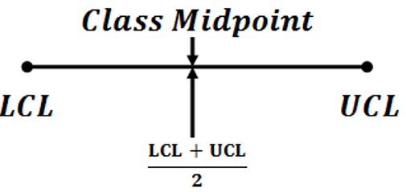
For each class interval, (LCL, UCL), the class midpoint or mark is the value in the middle of class intervals.
General Layout:
Range (6.9) & Tol (0.1)
⬇
Class Width (1.4)
⬇
Class Limits
(LCL & UCL) (6.8 & 8.1)
⬇
Class Midpoints
(Marks)
⬇
Class Boundaries
⬇
Frequency Table
⬇
Histogram
LCL | UCL | Class Mark
6.8 | 8.1 | 7.45
8.2 | 9.5 | 8.85
9.6 | 10.9 | 10.25
11.0 | 12.3 | 11.65
12.4 | 13.7 | 13.05

Slide 8
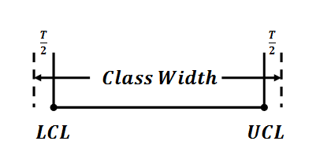
Class Boundaries are derived after removing the space between two consecutive class limits. The size of the gap is equal to Tolerance. Therefore
General Layout:
Range (6.9) & Tol (0.1)
⬇
Class Width (1.4)
⬇
Class Limits
(LCL & UCL) (6.8 & 8.1)
⬇
Class Midpoints
(7.45)
⬇
Class Boundaries
⬇
Frequency Table
⬇
Histogram
CW
LCB = LCL – (Tol./2)
UCB = UCL + (Tol./2)
LCB
UCB
LCL | UCL | Class Mark
6.8 | 8.1 | 7.45
8.2 | 9.5 | 8.85
9.6 | 10.9 | 10.25
11.0 | 12.3 | 11.65
12.4 | 13.7 | 13.05
LCB | UCB
6.75 | 8.15
8.15 | 9.55
9.55 | 10.95
10.95 | 12.35
12.35 | 13.75

Slide 9


LCL | UCL | Class Mark | LCB | UCB | freq. | r (%)
6.8 | 8.1 | 7.45 | 6.75 | 8.15 | 6
8.2 | 9.5 | 8.85 | 8.15 | 9.55 | 15
9.6 | 10.9 | 10.25 | 9.55 | 10.95 | 16
11.0 | 12.3 | 11.65 | 10.95 | 12.35 | 9
12.4 | 13.7 | 13.05 | 12.35 | 13.75 | 4
Sum |  |  |  |  | 50 | 100
General Layout:
Range (6.9) & Tol (0.1)
⬇
Class Width (1.4)
⬇
Class Limits
(LCL & UCL) (6.8 & 8.1)
⬇
Class Midpoints
(7.45)
⬇
Class Boundaries
⬇
Frequency Table
⬇
Histogram
freq.
16
15
9
6
4
7.45
8.85
10.25
11.65
13.05
Nylon ropes breaking point (kN)
Notes:
Once we have the class boundaries, we count the frequency of numbers within each category and add it to the frequency table. Graphing the histogram is easy having these frequencies, simply draw rectangles with heights proportional to frequencies or relative frequencies.
You can either mark the class marks on the x-axis or the class boundaries.

Slide 10
Question
Complete the following table. Identify the class width, class midpoints, and class boundaries.
Class Intervals | frequency | Class (Marks) | Class Boundaries Lower Upper
10 – 16 | 8
17 – 23 | 12
24 – 30 | 15
31 – 37 | 5
Notes:
13 9.5 16.5
20 16.5 23.5
27 23.5 30.5
34 30.5 37.5

Slide 11
Ogive Graph
frequency | Class Boundary | Cum freq. | Rel. Cum. freq. %
1 | 1.5 2.5
5 | 2.5 3.5
4 | 3.5 4.5
2 | 4.5 5.5
1 | 5.5 6.5
Ogive graph is a representation of cumulative frequencies. To graph it
1
7.7 %
6
46.2 %
1. Generate a frequency table similar to the process for histograms. The table should have columns of frequency and class boundaries.
10
76.9 %
12
92.3 %
13
100 %
2. Add a column of Cumulative frequencies and Relative Cumulative frequencies in Percent.
Rel. Cum. Freq %
=
100* Cum. Freq / n
3. Graph the chart using Class Boundaries and RCF% by placing dots on the chart. Start with (LCB₁, 0%), then at (UCB, RCF%).
IMPORTANT
Ogive graph has an increasing pattern
Notes:
Practice graphing it for the given table, you can check it with the answer on the next page

Slide 12
Example
Class Boundary | Cum Freq | Rel. Cum. Freq %
1.5 2.5 | 1 | 7.7 %
2.5 3.5 | 6 | 46.2 %
3.5 4.5 | 10 | 76.9 %
4.5 5.5 | 12 | 92.3 %
5.5 6.5 | 13 | 100 %
Rel. Cum. Freq %
100
92.3
76.9
You can plot the Ogive graph using Cumulative frequencies too.
46.2
7.7
1.5
2.5
3.5
4.5
5.5
6.5
Outcome

Slide 13
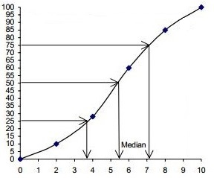
Q1 / Median / Q3
Crossing a 50% point on the y-axis with the Ogive chart marks the median. Crossing the chart at 25% and 75% marks Q1 and Q3 respectively which are the first and third quartiles.
Rel. Cum. Freq. %
In the given chart, what is the value of Q1, median, and Q3?
Notes:
Q1 ~ 26.5 median ~ 28 Q3 ~ 30
Your answer might be slightly different and that’s acceptable

Slide 14
Exercise
Given the following frequency table, plot an ogive graph and find Q1, median, and Q3.
freq. | Class Boundaries Lower Upper
8 | 9.5 | 16.5
12 | 16.5 | 23.5
15 | 23.5 | 30.5
5 | 30.5 | 37.5
Cum. freq. | Rel. Cum. freq. (%)
8
(8/40)*100=20%
20
(20/40)*100=50%
35
(35/40)*100=87.5%
40
100%

Slide 15
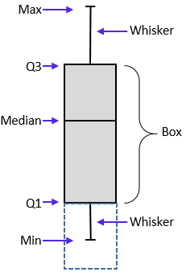
Box Plot
A box plot is a graph displaying five important numbers: minimum, first quartile, median, third quartile, and maximum.
1. Sort the data from smallest to largest
2. Find the Extremes: minimum and Maximum
3. Find the median: this is the middle number
4. Find Q ₁ and Q ₃: these are the first and third quarters
5. Graph the box plot according to the given sample
25%
1st Quartile
3rd Quartile
25%
The length of the box Q3-Q1 is called Inter Quartile Range
2nd Quartile
min
median
Max

Slide 16
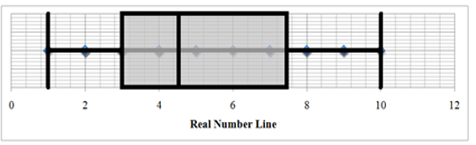
Example
Graph a box plot given the following data
3 7 2 10 3 1
8 4 4 3 2 4
5 9 6 9 5 2
8 7
Notes:
Sort the data first, 1 2 2 2 3 3 3 4 4 4 5 5 6 7 7 8 8 9 9 10
Then find the five number summary, minimum=1, and maximum=10
The center or the median=4.5, center on the first half Q1=3, and center on the second half Q3=7.5
Now graph the boxplot according to instructions, should be similar to what we have here.
Softwares might apportion the values and compute Q3=7.25

Slide 17
Exercise
Draw a box-and-whisker plot for the following data set (17 Observations):
4.3, 5.1, 3.9, 4.5, 4.4, 4.9, 5.0, 4.7, 4.1, 4.6, 4.4, 4.3, 4.8, 4.4, 4.2, 4.5, 4.4
Notes:
3.9, 4.1, 4.2, 4.3, 4.3, 4.4, 4.4, 4.4, 4.4, 4.5, 4.5, 4.6, 4.9, 4.7, 4.8, 5.0, 5.1

Slide 18
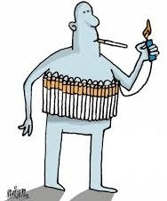
Practice Problems Part 2
1. The following table contains the nicotine content in milligrams (mg) per cigarette for 29 popular cigarette brands
a) Construct a histogram of the nicotine content with 7 classes and give a clear description of the distribution (shape, center, spread and outliers) in the context of the study.
b) Construct a boxplot of the nicotine content and give a clear description of the distribution (shape, center, spread and outliers) in the context of the study.
Do this first with a paper and pencil, then use your calculator to graph the charts and compare the results.
Notes:
It is time to practice
Answers are provided in Ch2 Practice Problem Solutions

Slide 19
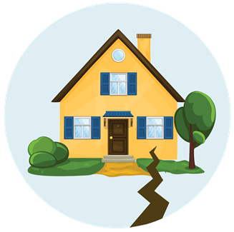
Practice Problems Part 2
2. The ages of females and males who died of sudden cardiac causes after 4:31 am on the day of the Northridge Earthquake are given below.
a) Construct a histogram of the ages of males and give a clear description of the distribution (shape, center, spread and outliers). Use six classes.
b) Construct a boxplot of the ages of females and give a clear description of the distribution (shape, center, spread and outliers).
c) Construct a side-by-side boxplot and compare the distribution of the ages between males and females (shape, center, spread and outliers).
Female | 77 | 83 | 75 | 77 | 70 | 80 | 68 | 58 | 70 | 81 | 78 | 69 | 38
Male | 90 | 38 | 45 | 47 | 79 | 75 | 71 | 68 | 51 | 55 | 66 | 56 | 59 | 60 | 68 | 64 | 53 | 90
Notes:
Answers are provided in Ch2 Practice Problem Solutions

